Slide 1
SMART PROJECT MANAGEMENT SYSTEM
2021-234

Slide 2
Overall Project Description

Slide 3
Overall Project Description
Research Problem
Current student grouping process is not effective.
Managing and checking progress of projects is a exhausting process.
Existing project management systems doesn’t include a peer review facility.
Students having difficulty to find a project.

Slide 4
Main Objective
Develop a Project Management System to improve team work skills among students and Automate current project management system.

Slide 5
Sub Objectives
Research Objectives
Develop a component to auto generate project groups to create balanced group.
Develop a component to peer review students to get an idea about each student.
Develop a component to track project progress using GitHub
Develop a component to track client meetings and record content using voice to text methodology.

Slide 6
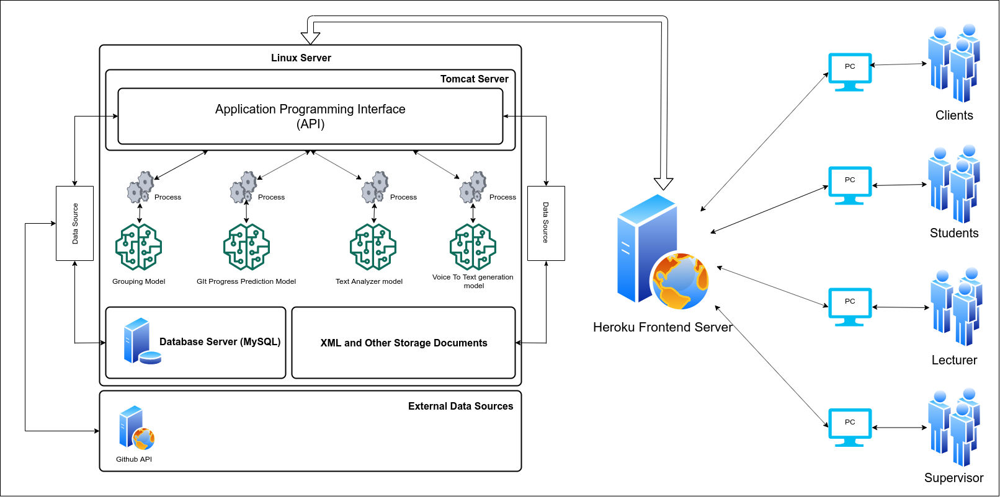
Overall Project Description
System Diagram

Slide 7

IT18009446 Amarasekara T.N.E. IT
Research Section 1
Automate Project Group Generation

Slide 8
Introduction
Research Question
Specific and Sub Objectives
EVIDENCES FOR THE COMPLETION

Slide 9

Research Question
Is random student group generation effective for group projects?
What are the other possible ways to automate group generation instead of random group generation?
What should be considered when we group students?

Slide 10
Specific and Sub Objectives
Specific Objectives
Develop a grouping algorithm to automate student grouping process
Sub Objectives
Data collection.
Analyze the data and find relationships between data.
Using data analysis find an optimal algorithm or algorithms to achieve the expected results
Test algorithms and output a model that can be used for the grouping process.

Slide 11
Research Methodology
grouping algorithm
Evidence for completion
Future work

Slide 12
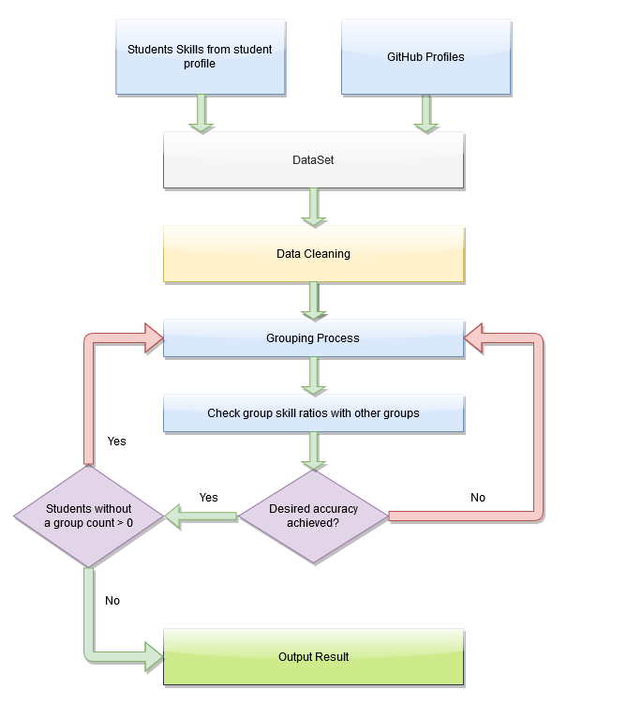
Grouping Algorithm
Data Requirements
Student GPA
Programming Skills
Base Languages
Frameworks
DBM systems
Version Controlling
Previous Projects
Used programming languages
GitHub Repositories
Used programming languages
✔
✔
✔
✔
✔
✔
✔
✔

Slide 13
Evidence for completion
Grouping Algorithm
Create Initial Groups
Create Group Balancer
Create Group Balance Iterator
Output Results
✔
✔
✔
✔

Slide 14
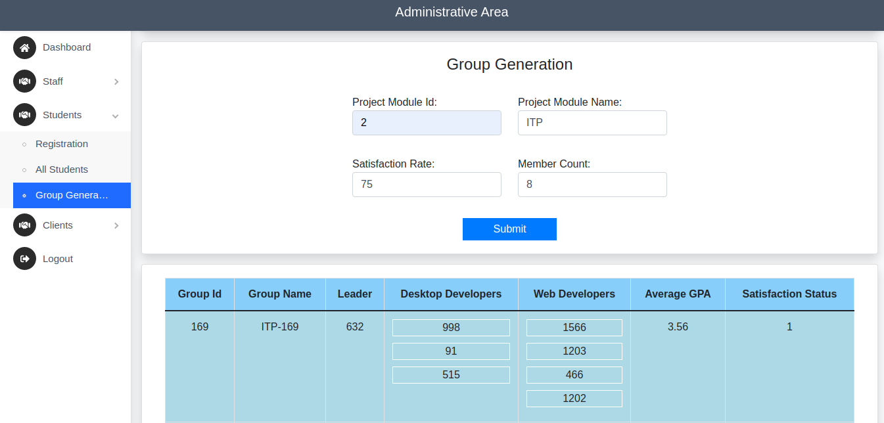
Evidence for completion
Previous Demo Grouping Result (Create Initial Groups)

Slide 15
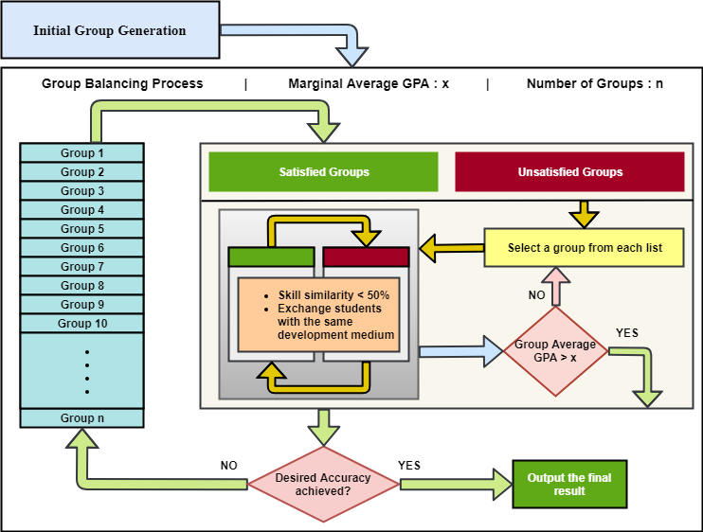
Evidence for completion
Group Balancer

Slide 16
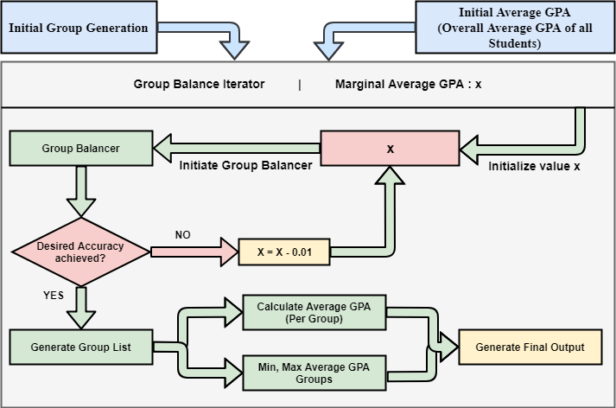
Evidence for completion
Group Balance Iterator

Slide 17
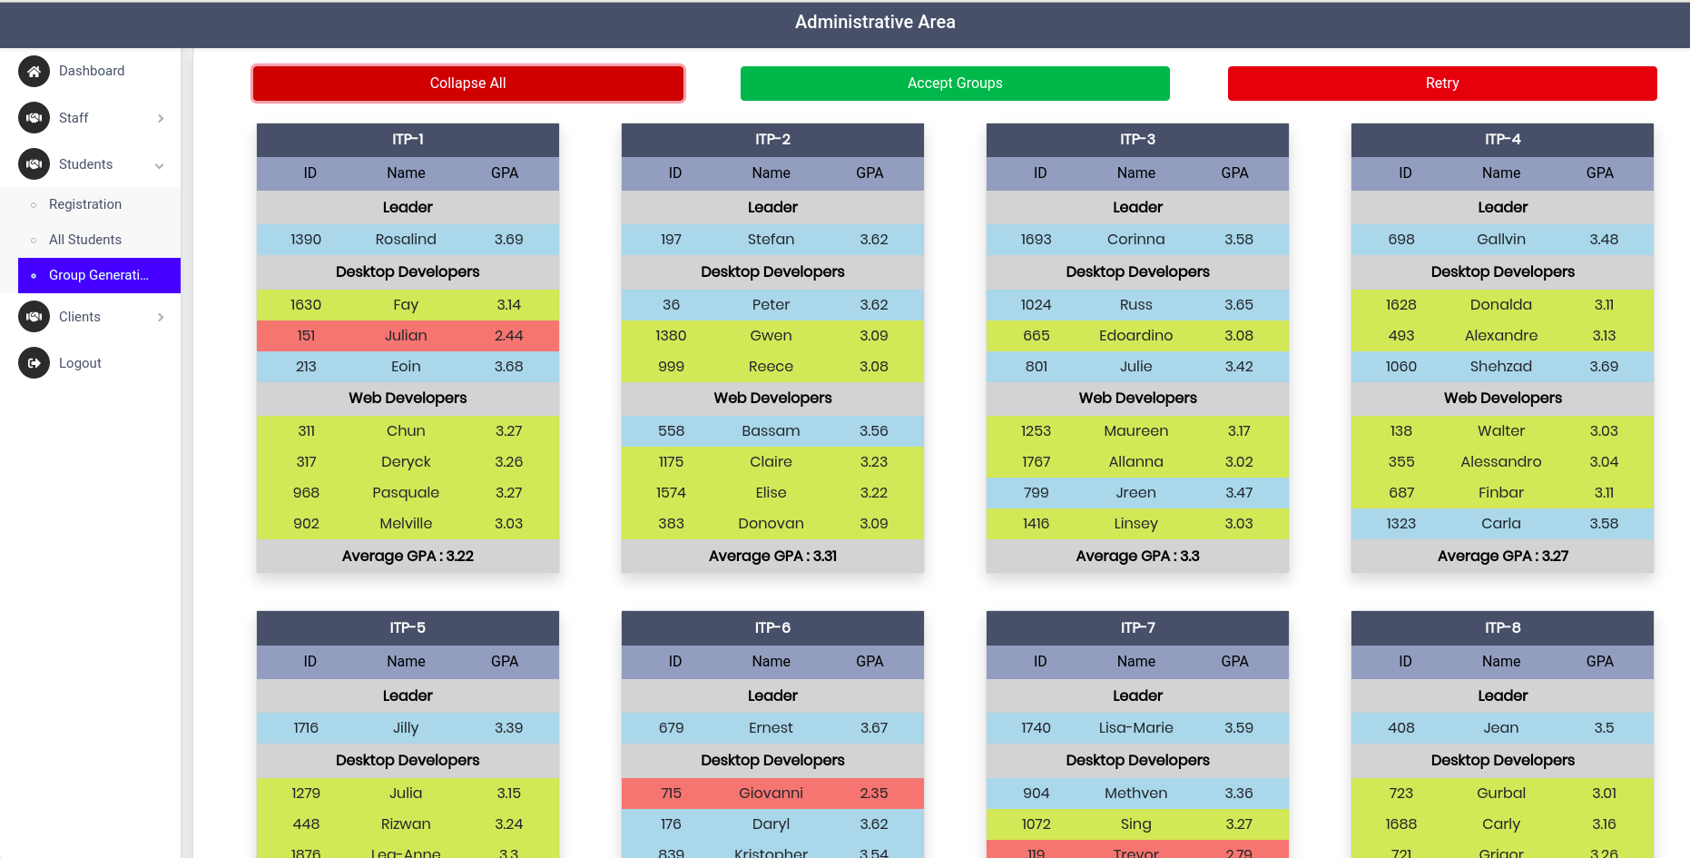
Evidence for completion
Final Demo Grouping Result

Slide 18
References
[1] Kmeans Clustering, Available at
https://scikit-learn.org/stable/modules/generated/sklearn.cluster.KMeans.html
[2] Decision Tree Classifier, Available at
https://scikit-learn.org/stable/modules/generated/sklearn.tree.DecisionTreeClassifier.html
[3] Why Diverse Teams Are Smarter, Available at
https://hbr.org/2016/11/why-diverse-teams-are-smarter

Slide 19

IT18140330 Gamage O.M. SE
Research Section 2
Predict future GitHub contribution and Progress Tracking

Slide 20
Introduction
Research Questions
Specific & sub Objectives

Slide 21

Research Questions
Are Students usually use any version controlling systems for their university modules?
Can we track GitHub users’ project? How we are going to track the progress?
Are there any existing project management system to predict contribution and track the project progress using GitHub?
What should be considered when we track the progress?
Are there any Incorporating version controlling facilities in project management?

Slide 22

Objectives
Predict Future Contribution and Progress Tracking using GitHub REST API.
Sub Objectives
Create system component to Track the project progress using GitHub REST API.
Task Management Dashboard to handle Tasks.
Creating Issue Tracking system similar as stack overflow.
Generating Performance report.

Slide 23

Research Methodology
Methodology

Slide 24
Methodology
Predict Future Contribution and Progress Tracking using GitHub REST API.
Create Project Environment and add GitHub data.
Track the Project Progress using GitHub REST API .
Predict Future Contribution for each member using weekly commits progress.
Assign Tasks and Manage Tasks.
Share Issues/ Errors / Questions in SMARTIssues.
Generating Performance report.

Slide 25
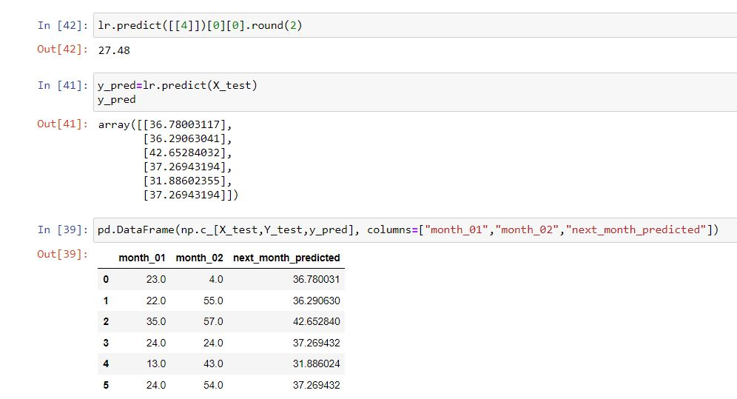
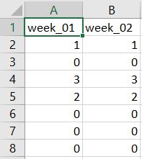
Methodology – Predict Future Contribution
Dataset – Collect each member’s weekly commit contribution.
Predict using Supervised Learning Algorithm.

Slide 26
Evidences
Evidences for the completion

Slide 27
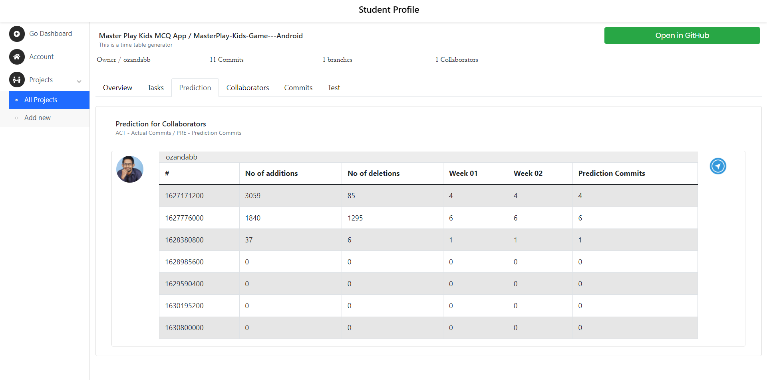
Prediction per Each Member

Slide 28
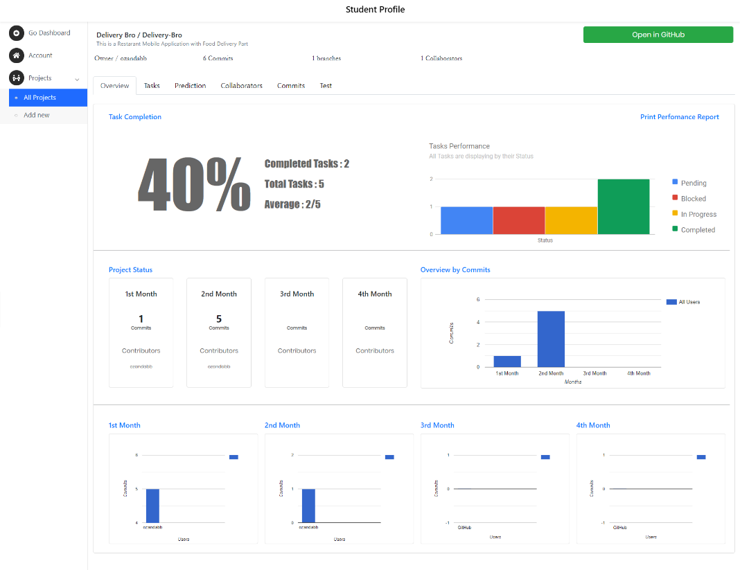
Project Overview

Slide 29
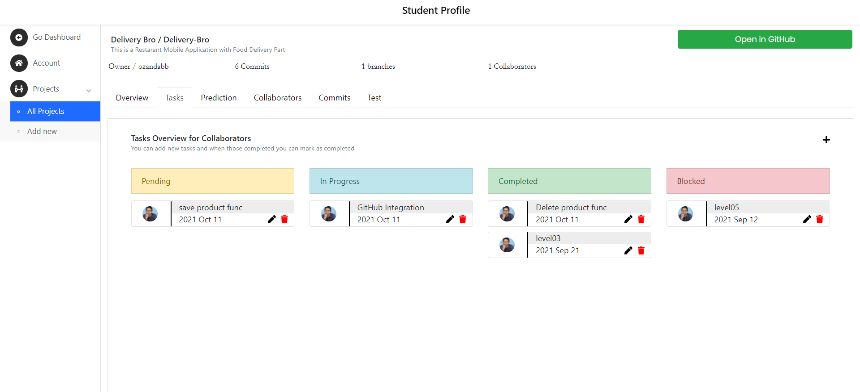
Task Management Dashboard

Slide 30
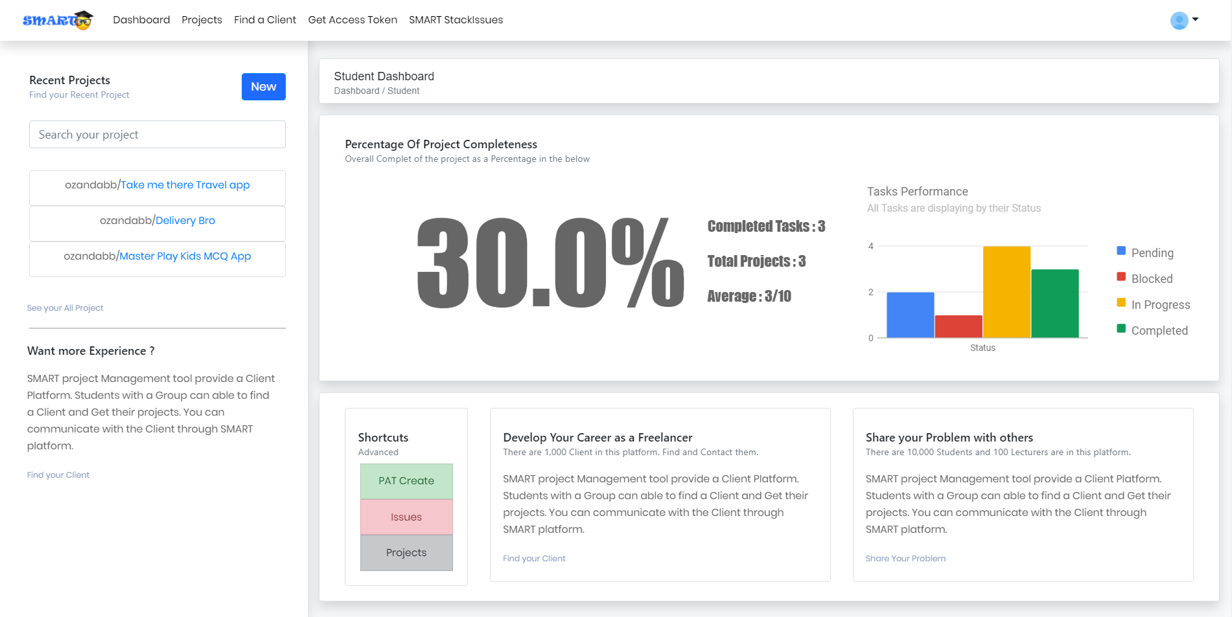
Student Dashboard

Slide 31
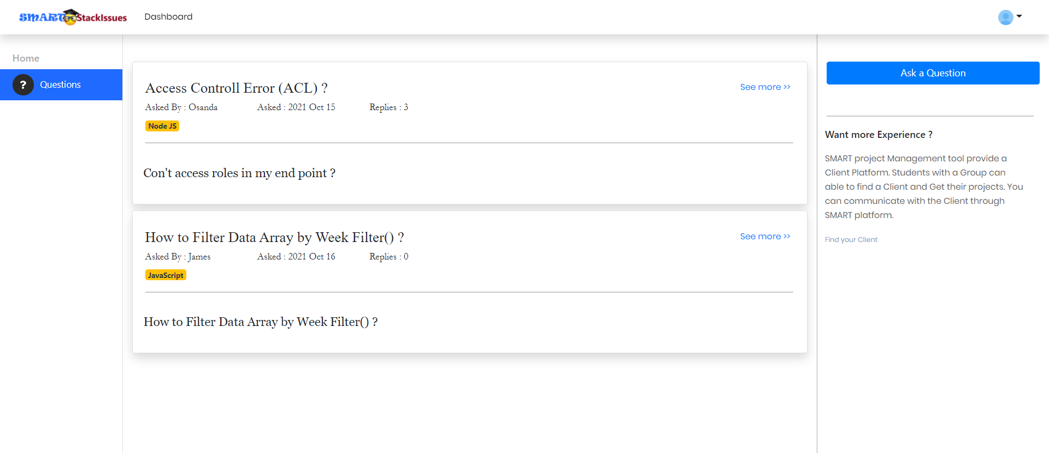
Issues Tracking

Slide 32
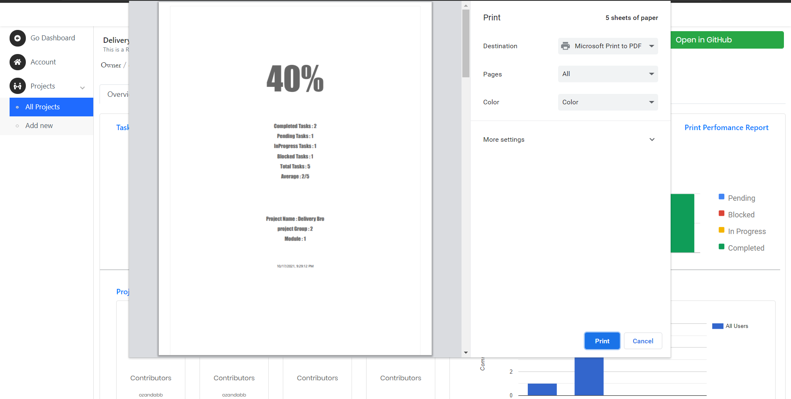
Performance Report

Slide 33








Technologies and Tools
Client side – React JS, Redux, Boostrap, CSS
Server Side – Node JS, Java, Python
Database – MySQL, MongoDB
Communication - REST, AJAX, JSONs
Tools - Visual Studio Code, Apache Server, Eclipse IDE, Postman

Slide 34
References
[1] GitHub User insight using GitHub API – Data Collection and Analysis, Available at https://towardsdatascience.com/github-user-insights-using-github-api-data-collection-and-analysis-5b7dca1ab214
[2] GitHub Documentation Guide, “Creating a personal access token”, Available at https://docs.github.com/en/github/authenticating-to-github/keeping-your-account-and-data-secure/creating-a-personal-access-token
[3] GitHub Documentation Guide, “ Users “ , Available at https://docs.github.com/en/rest/reference/users
[4] IEEE, “Using Dynamic and Contextual Features to Predict Issue Lifetime in GitHub Projects”, 2016 IEEE/ACM 13th working Conference on MSR.
[5] Zhuang Liao, Mengjie Yi, Yan Wang, Shengzong Liu, Hui Liu and Yan Zhang, “Healthy or Not: A Way to predict ecosystem health in GitHub”, 28 January 2019

Slide 35

IT18129236 Isurindi H.G.P IT
Research Section 3
Track client meetings and document meeting content using voice to text conversion.

Slide 36
Introduction
Research Question
Objectives

Slide 37

Research Question
Can Students remember all the client requirements? Or what they communicated with the client?
Are there any existing systems for this research part?
Are students need to take notes in a meeting? Or Are Students need to remember all the details from the client meeting?
Can the client can track the project progress? And Can the client blame for the project coordinators for any failures?

Slide 38
Objectives
The main objective is emotional and speech recognition into auto generated report and a satisfaction rate.
Sub Objectives
Creating client meeting platform
Client portal which provide facility to propose projects
Suggest Functions for students which inserted by students

Slide 39
Research Methodology
Methodology

Slide 40
Methodology
Created Client meeting platform
Client portal which provide facility to propose projects
Created voice to text converter to track the client meeting.
Create the recording functions of the meeting.
Student can download the final report and get the satisfaction rate
Student can download video recording for there future requements.

Slide 41
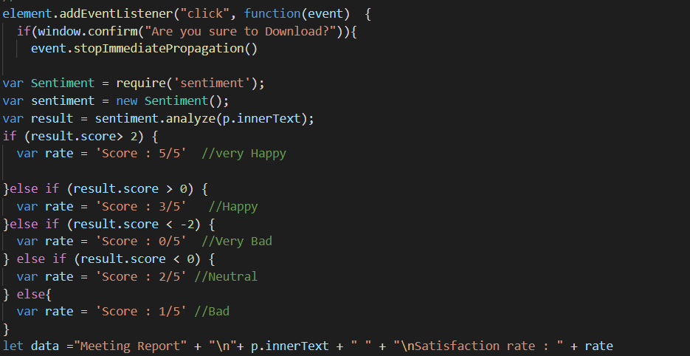
Satisfaction rate calculation
Calculate the client satisfaction rate as a text, score out of 5
Use the “sentiment.analyze” library to calculate the rate

Slide 42
Evidences
Evidences for the completion

Slide 43
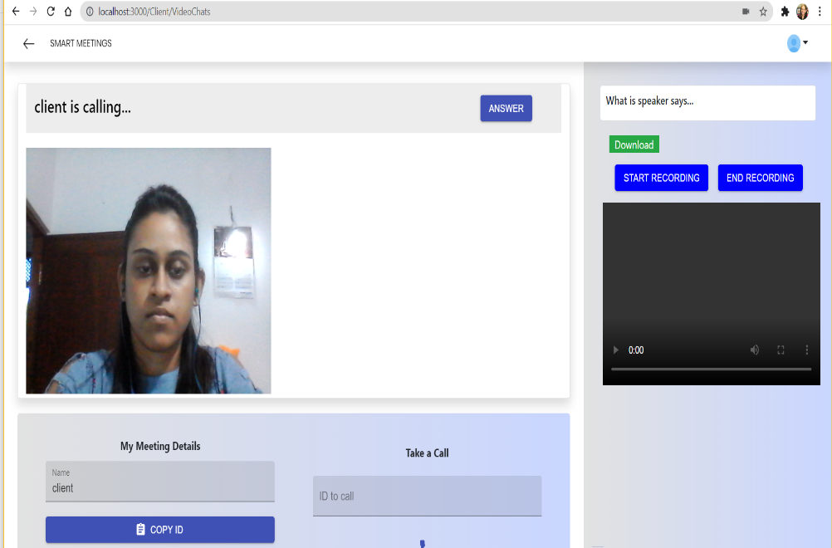
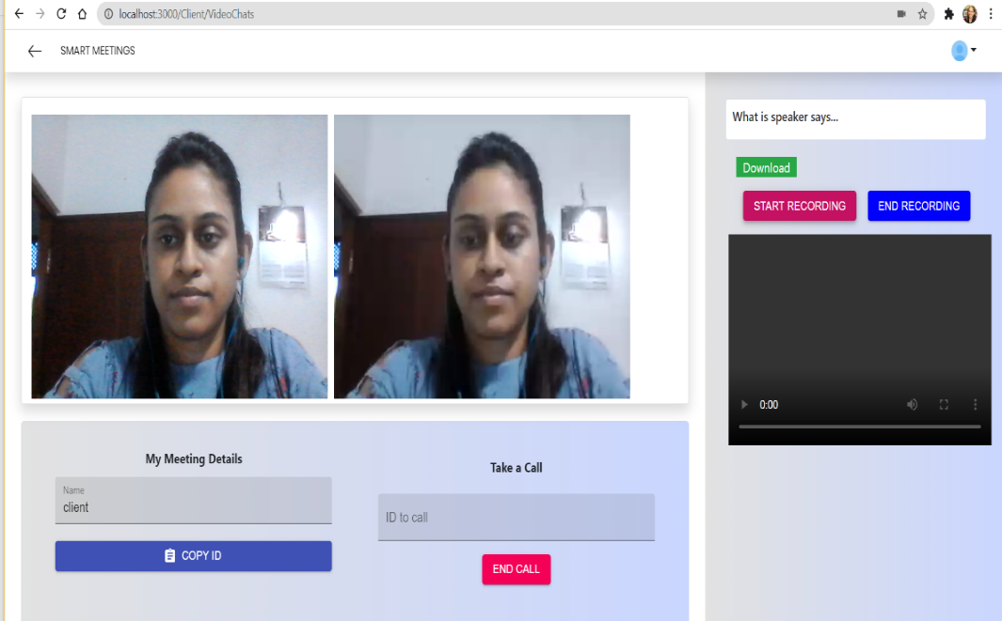
Client meeting platform and start the meeting

Slide 44
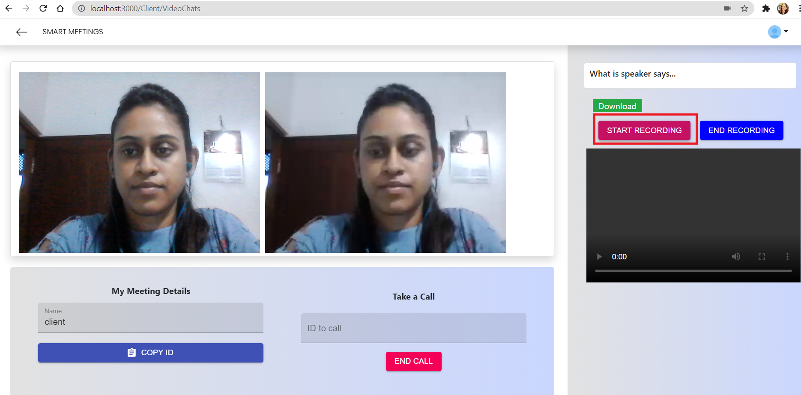
Start Recording …

Slide 45
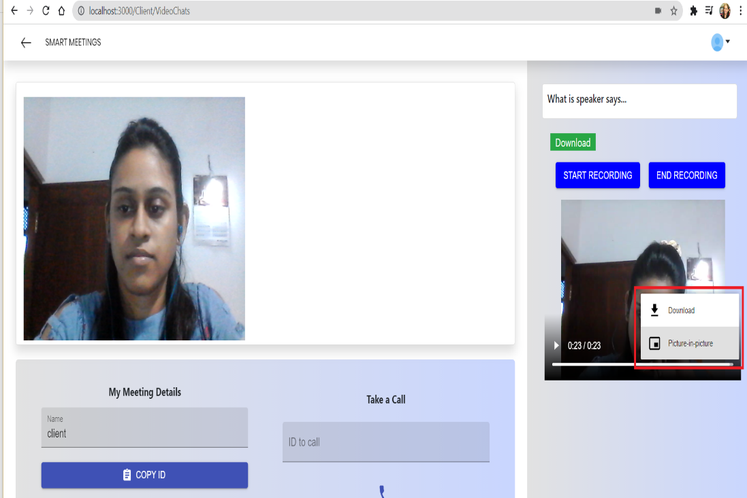
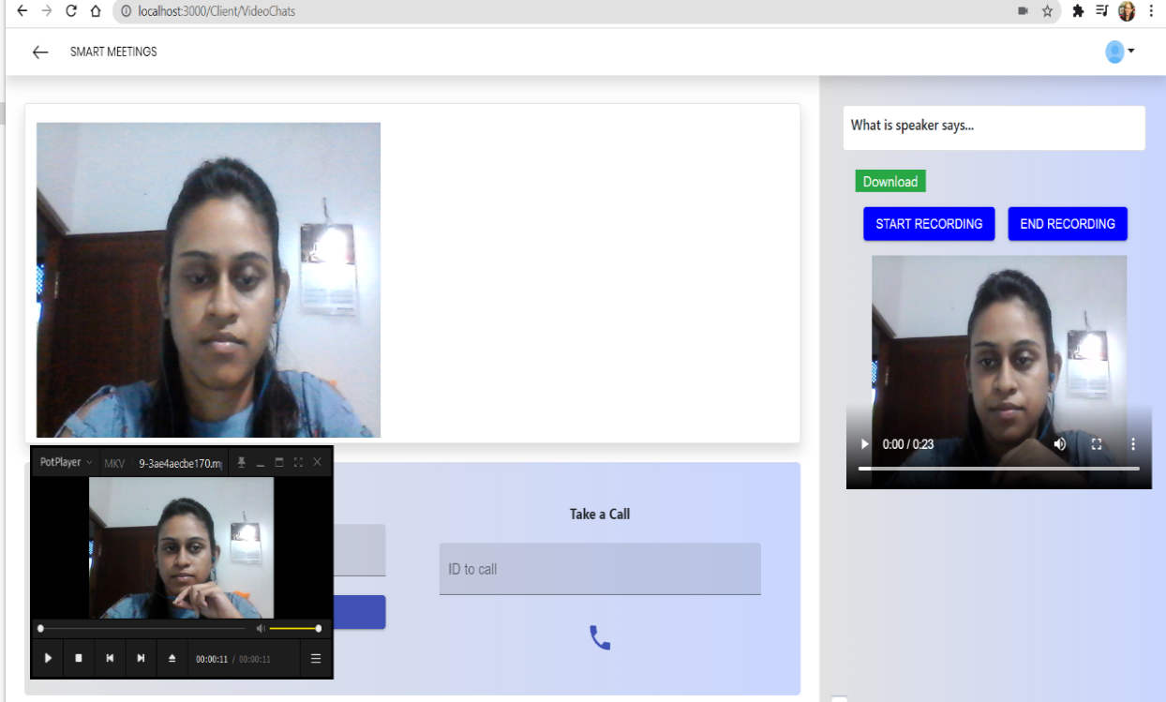
End Recording and Download the video

Slide 46
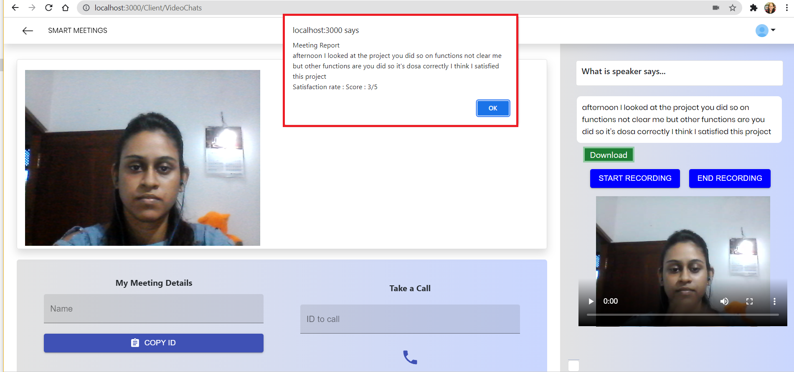
Calculate the client satisfaction rate

Slide 47
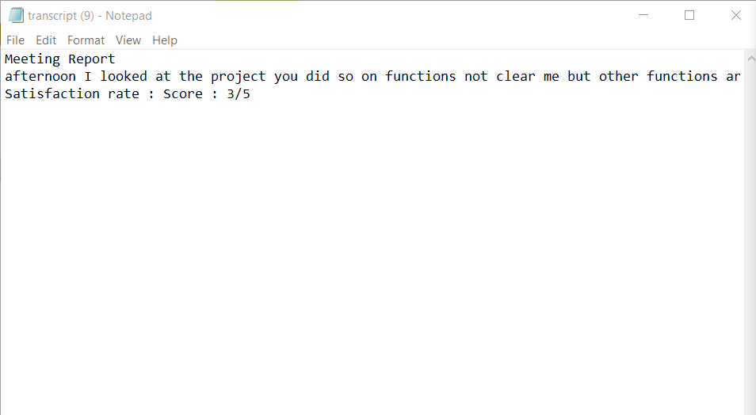
Meeting Transcript

Slide 48
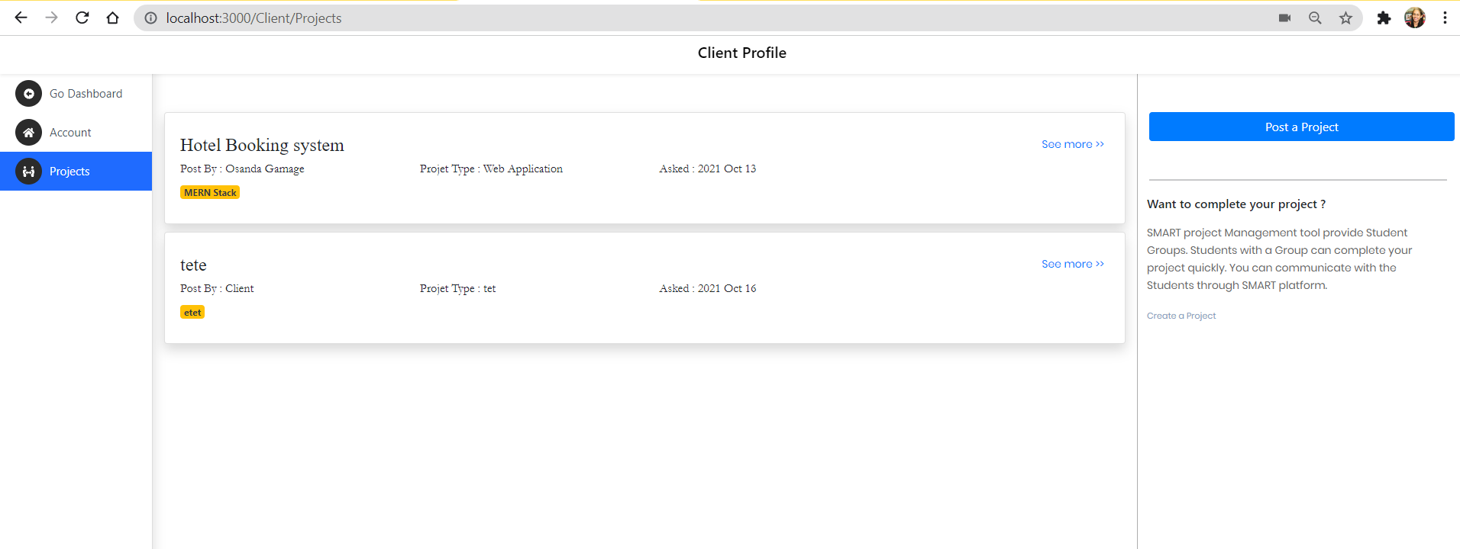
Propose projects

Slide 49

Future work
Need to host the meeting platform and complete the research successfully

Slide 50
Technologies and Tools
Client side – React JS, Redux, Boostrap, CSS
Server Side – Node JS, Java, Python
Database – MySQL, MongoDB
Communication - REST, AJAX, JSONs
Tools - Visual Studio Code, Apache Server,

Slide 51
References
[1] Lowerre B.T. , “The Happy Speech Recognition System”, Ph.D. Thesis Carnegie-Mellon University, Pittsburgh, PA, Available at
[2] “Face recognition methods and applications” , Cornell University, 2014, Available at https://arxiv.org/abs/1403.0485
[3] Relationships between SCL theories and methods, adapted from Bishop and Verleger (Bishop and Verleger2013)
[4]The Free Rider and Cooperative Learning Groups: Perspectives from Faculty Members Geri McArdle Kimberly D. Clements Kim Hutchinson- Lendi
spech recognition website - https://realpython.com/python-speech-recognition/

Slide 52

IT18003642 Navanjana E.H.D.T.D. IT
Research Section 4
Peer Review Assessment

Slide 53
Introduction
Research Methodology
Results and Discussion

Slide 54
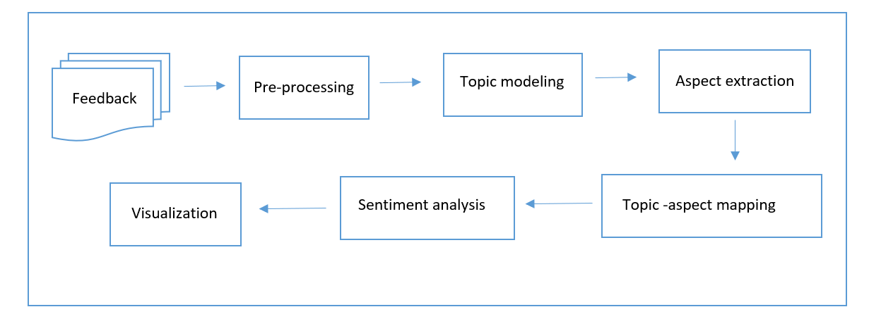
Research Methodology PP1
A1
A3
A2
A1 - Topic Modeling and Topic Aspect Mapping , A2 - Aspect Specific Sentiment Analysis , A3 - Finding Aspect on Sentiments

Slide 55
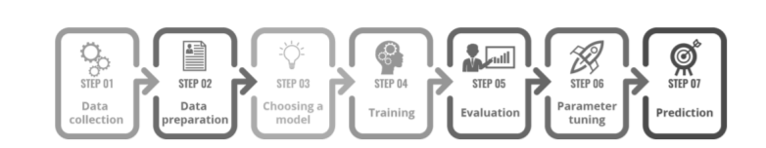
Research Methodology PP1

Slide 56
Research Methodology PP2
A1
Visualization
A3
A2
A1 - Topic Modeling and Topic Aspect Mapping , A2 - Aspect Specific Sentiment Analysis , A3 - Finding Aspect on Sentiments

Slide 57
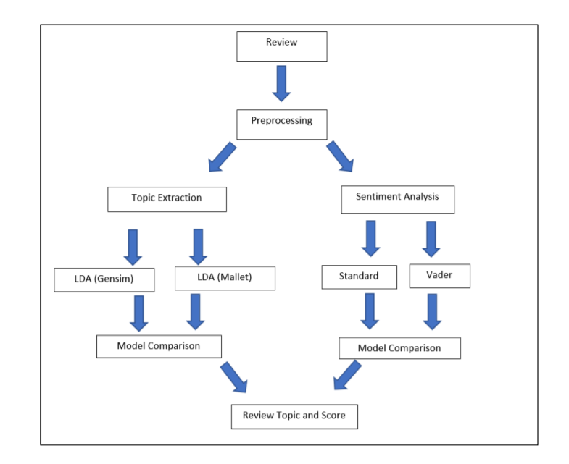

Slide 58
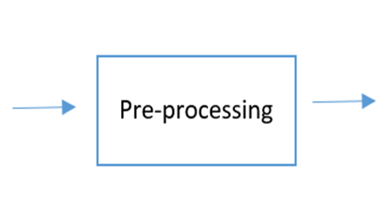
Preprocessing pp1
Must Do:
Noise removal
Lowercasing
Should Do:
Simple normalization
Task Dependent:
Stop-word removal
Advanced normalization
Stemming / lemmatization
Text enrichment /augmentation

Slide 59
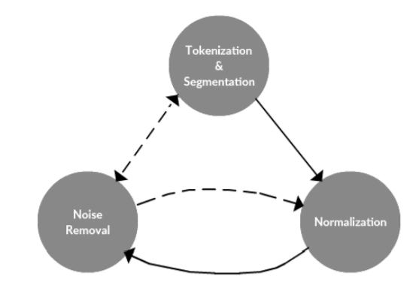
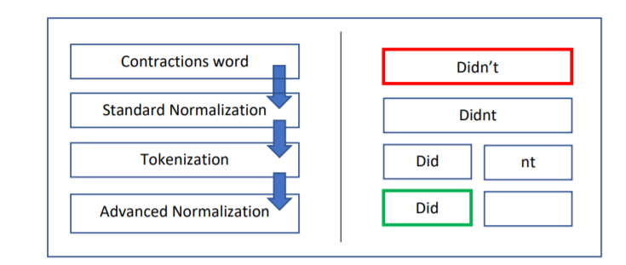
data preprocessing framework

Slide 60
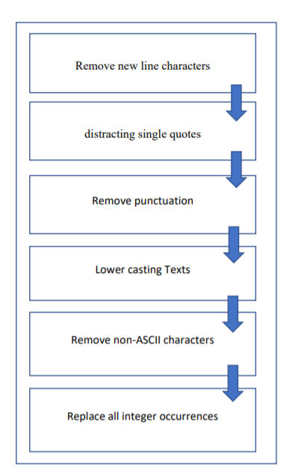
Normalization - standard

Slide 61
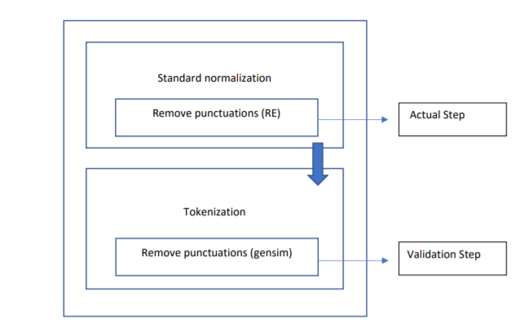
Validation process

Slide 62
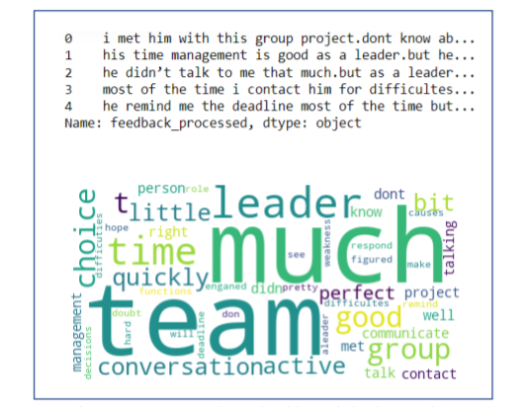
Exploratory Analysis
To verify whether the preprocessing, we’ll make a simple word cloud using the word cloud package to get a visual representation of most common words. It is key to understanding the data and ensuring we are on the right track, and if any more preprocessing is necessary before training the model.

Slide 63
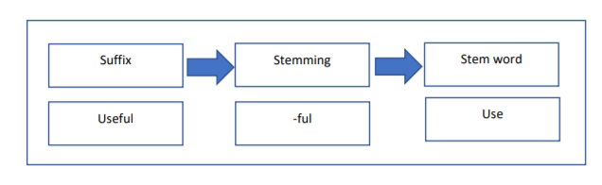
Normalization - Advanced
Stemming process

Slide 64
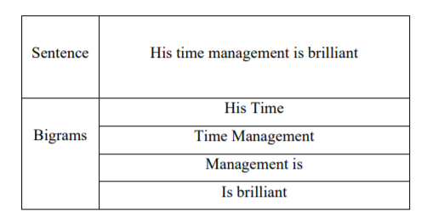
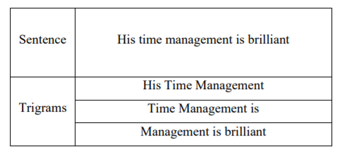
Normalization - Advanced
Phrase detection

Slide 65
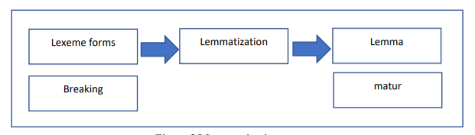
Normalization - Advanced
Lemmatization process

Slide 66
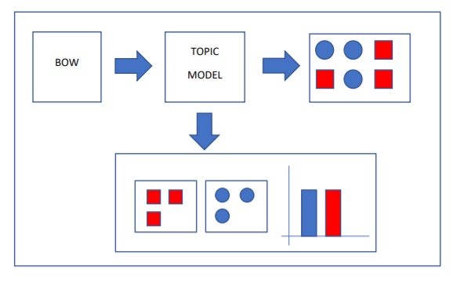
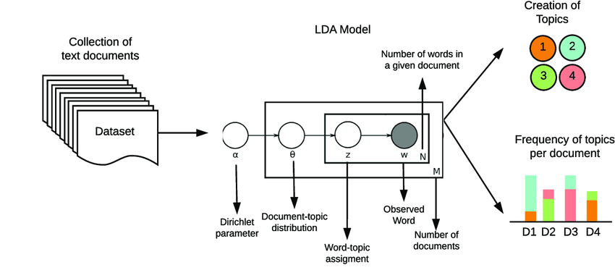
TOPIC MODEL

Slide 67
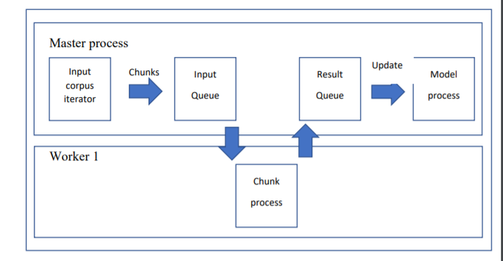
Model selection

Slide 68
Parameter tuning
Model parameters – Sentiment Analysis with VADER
Weight assignments
Model Hyperparameters – Topic model with gensim and mallet
Alpha
Beta
Coherence

Slide 69
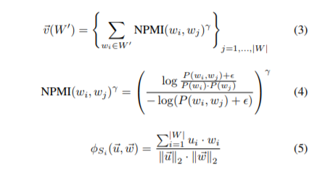
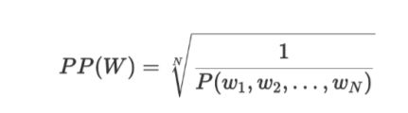
Model comparison and evaluation
Coherence score ( C_v , UMASS )
Perplexity score

Slide 70
Results
Preprocessing validation with exploratory analysis

Slide 71
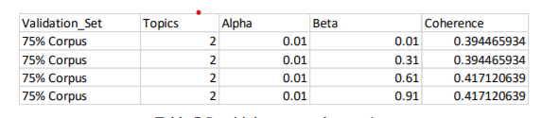
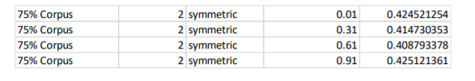
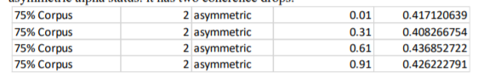
Results
Hyperparameter tuning

Slide 72
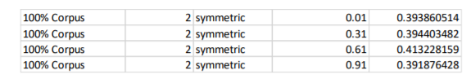
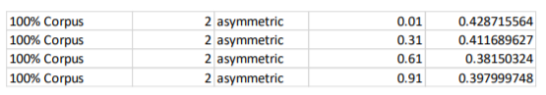
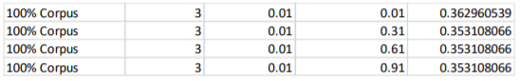
Results
Hyperparameter tuning

Slide 73
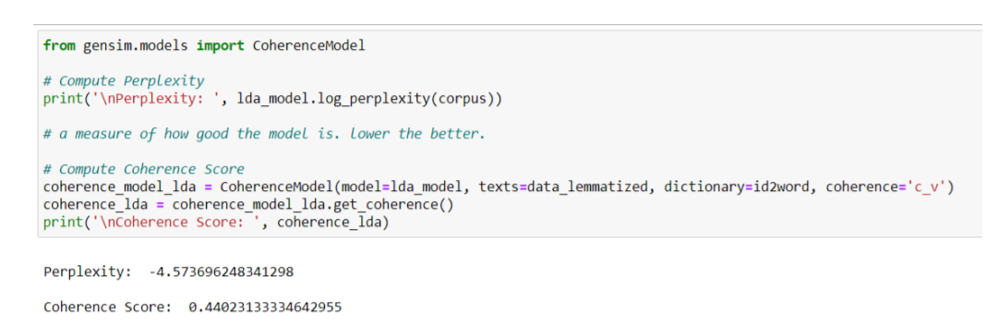
Results
Model evaluation

Slide 74
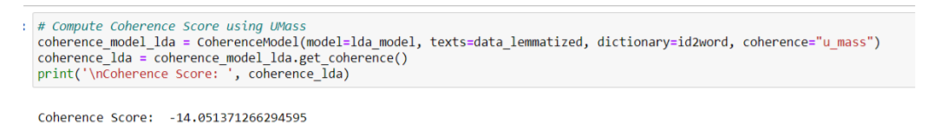
Results
Model evaluation

Slide 75
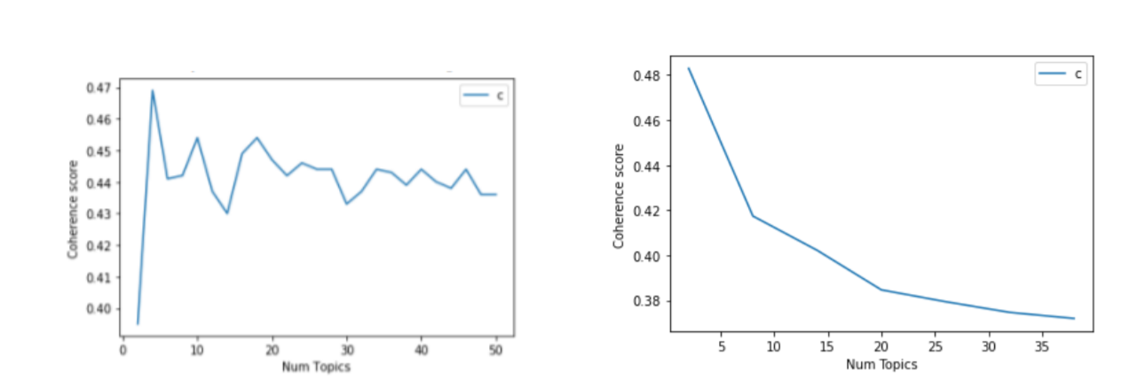
Results
Plotting coherence drop

Slide 76

Results
Dominant topic coverage

Slide 77

Results
topic contribution coverage

Slide 78

Results
Sentiment score

Slide 79


